Slide 1

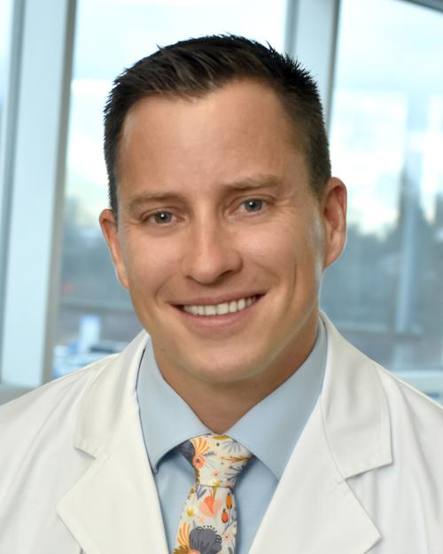


Weight Loss
Warriors Newsletter Quarter 3 2025
The Healthy Crew: Getting to know your Surgical Weight Loss Staff
Dr. Michael Devers
We would like to extend a very warm welcome to the St. Joseph Weight Loss Center’s newest surgeon.
I am a board-certified general surgeon with advanced training in minimally invasive, robotic and bariatric surgery. I also perform anti-reflux surgery, hiatal hernia repair, complex hernia repair, as well as gallbladder and colon/rectal surgeries. In my free time, I’ve earned my pilots license and greatly enjoy flying. I also have a passion for sailing, wakeboarding, golfing and participating in nearly any organized sport.
For an exceptional weight loss experience and follow-up care call to schedule your appointment today.
SWLC Support Group Meetings:
Did you know there is a “Dose-Effect” to support group meetings both before and after weight loss surgery. Those patients that participate on a regular basis achieved more long-term weight-loss following surgery than those who do not attend, with the frequency of attendance associated with greater weight-loss long-term.
Tuesday, July 22nd 2025, at 5:30 pm Benefits of Psychological Well Being Pre-Op and Post-Op – By New Vision Behavioral Health Services Presenters: Robert Murray and Madelynn Phillips Location: Surgical Weight Loss Center
Tuesday, August 26th 2025, at 5:30 pm Beat the Summer Heat Why is hydration so important after weight loss surgery? How do you know if you are hydrated? Presenter: Kim Triveri RDN LD Location: Surgical Weight Loss Center
Tuesday, Sept. 16th 2025, at 5:30 pm Ask the RD what is in my shopping cart? Presenter: Kim Triveri RDN LD Location: To Be Determined - Grocery Store Site
Tuesday, Oct. 21st 2025, at 5:30 pm New research on food is medicine and how RD’s are changing nourishment and what we know about our food. Presenter: Kim Triveri RDN LD Location: Surgical Weight Loss Center
St. Joseph Weight Loss Center Lab – 452 Broadway Street – Youngstown, OH
“Opening Soon” Did you hear the great news! The St. Joseph Weight Loss Center is thrilled to announce the upcoming launch of our own in-office lab facility, dedicated to conducting routine post-op bariatric lab tests starting in 2025. Stay tuned for updates on the official opening date and hours of operation!
St. Joseph Weight Loss Center
452 Broadway Ave.
Youngstown, Oh 44504
Phone: 330-480-2866
Call for an appointment.

Slide 2
Weight Loss Warriors Newsletter
At the St. Joseph Weight Loss Center A Lifetime of Wholeness Awaits You:
Lifelong follow-up and lab work are essential after weight loss surgery. Obesity is now understood to be a chronic, progressive disease influenced by both genetic and environmental factors, not simply a matter of willpower or overeating. Because of its complex and ongoing nature, obesity requires lifelong management, especially following weight loss surgery.
Weight loss surgery is a powerful tool for improving health, but it also brings long-term changes to the body’s metabolism and nutrient absorption. That’s why ongoing medical follow-up and yearly lab work are so important. Regular checkups allow healthcare providers to monitor for any potential complications and help patients maintain their weight loss, address weight gain and stay healthy and fit for the long run.
Key Reasons for Annual Lab Work:
Monitoring Nutritional Deficiencies:
Weight loss surgery procedures can reduce the body’s ability to absorb essential nutrients. Regular bloodwork helps track levels of iron, vitamin B12, calcium, vitamin D, and other key nutrients to prevent serious deficiencies. It can take time for nutrient stores to deplete, and people may become more relaxed in their eating habits and taking their recommended supplements which contribute to these deficiencies as patients become further post-op.
Managing Metabolic Changes:
Weight loss surgery may lead to shifts in metabolism, such as changes in electrolyte balance or acid-base levels. Lab tests help catch these changes early and ensure they are properly managed to prevent weight gain.
Early Problem Detection:
Routine lab testing allows doctors to spot health issues before they become serious or cause noticeable
symptoms, enabling early treatment and better outcomes.
Personalized Ongoing Care:
Each patient’s needs are different, depending on the type of surgery and their individual health profile. Annual lab work helps doctors customize follow-up care and make timely adjustments to treatment this includes dietary changes, exercise patterns, metabolism support, revisions, re-operations and use of weight loss medications.
Preventing Long-Term Complications:
With regular monitoring, potential issues like anemia, bone loss, or weight regain can be caught early—reducing the risk of long-term health problems.
Be sure to call and schedule your follow-up appointment today
Why must you lose weight before having weight loss surgery?
Losing weight before surgery will lower the risk of complications and make weight-loss surgery safer. The main purpose of losing weight before weight-loss surgery is to reduce body fat in the abdominal region, especially in and around the liver. Also, by losing weight before surgery we see shorter operating times, reduced length of hospital stays, early implementation of healthy habits, and reduced risk of infections, blood clots, and heart attacks following weight loss surgery.
St. Joseph Weight Loss Center
452 Broadway Ave.
Youngstown, Oh 44504
Phone: 330-480-2866
Call for an appointment.

Slide 3


Weight Loss Warriors Newsletter
Summer Hydration Tips:
A new study suggests that milk may be more effective at rehydrating the body than water or sports drinks. This is primarily due to milk's electrolyte content (sodium and potassium) and its ability to be absorbed more slowly, leading to longer-lasting hydration.
Here's why milk may be a better choice for hydration:
Electrolytes:
Milk contains electrolytes like sodium and potassium, which are crucial for fluid balance and retention in the body.
Slows Fluid Emptying:
The natural sugar, fat, and protein in milk helps slow down the rate at which fluids leave the stomach, allowing for more sustained hydration, according to a study.
Maintains Hydration:
The body may retain fluids better after consuming milk compared to water or sports drinks.
Study Results:
One study found that milk was better at maintaining hydration levels after exercise, likely due to its electrolyte content and energy density.
While water is essential for hydration, milk can be a valuable alternative, especially in situations where prolonged hydration is needed, plus the added benefit of helping meet protein needs after weight loss surgery.
Tip: Make sure to select Skim, Low-Fat or Fat Free Milk
Fitalicious Recipe Corner: By Kim Triveri, RDN LD
Mediterranean-Style Tomato Tuna Salad
Ingredients:
15 oz Can of Tuna in Spring Water, drained
13 oz (approx. 4 large) Roma Tomatoes, diced
3.5 oz Fat-Free Greek-Style Feta Cheese Crumbled
15 oz Can Cannellini Beans, drained
1 cup finely chopped parsley
1 small red onion, finely diced
8.8 oz bag pre-cooked quinoa
Diced Cucumber, optional
Dressing:
3 tablespoons Balsamic Vinegar
1 tablespoon Olive Oil
1 teaspoon Salt
1/4 teaspoon Black Pepper
Instructions
Dice the tomatoes and cucumbers into small chunks, finely chop the red onion and parsley. Add the tuna to a large mixing bowl and flake it with a fork (or your fingers, if you prefer). Toss in beans.
In a small bowl or screw-top jar, combine balsamic vinegar, olive oil, salt, and pepper.
Whisk or shake well until fully emulsified.
In a large bowl, mix the pre-cooked quinoa, flaked tuna, diced tomatoes, cucumbers, red onion, parsley, and crumbled feta cheese.
Pour the dressing over the salad and toss thoroughly to ensure everything is evenly coated.
Bariatric Surgeons:
Dr. Benjamin Biteman
Dr. Michael Devers
Dr. Nicholas Gastaldo
Dr. Robert Woodruff
The biggest thank you we can receive is referrals that you send us from family and friends.
St Joseph Weight Loss Center Fun Facts
1st Surgery: 2002
Total Primary Bariatric Surgeries: over 3,000
Total Surgeries in 2024
Gastric Bypass – 93
Gastric Sleeve – 79
St. Joseph Weight Loss Center
452 Broadway Ave.
Youngstown, Oh 44504
Phone: 330-480-2866
Call for an appointment.

